Slide 1
The effectiveness of Music on Mental Illness: Depression and Anxiety
-Project 3-
Titus Muchiri, Richard Willet, Denise Miller
09-19-2024

Slide 2
Intro
Source:
Public Domain: Kaggle: Music and Mental Health Survery Results
Data Size:
33 Columns
736 rows
Variables:
Age
Frequency of Play per Genre
# of “Yes” response to improvement to mental Health

Slide 3
Music and the Muse
Rooted in the genes:
Cultural
Traditional
Comfort
Relaxation
TURN UP!!!!
While working:
Studying
Doing Menial tasks

Slide 4
What is….?
What is OCD?
Obsessive-compulsive Disorder
Uncontrolllable Thoughts and/or Engaging in Repetitive Behaviors.
What is Anxiety?
Persistent feeling of anxiety or dread
Triggered by situations, social environments and or phobias.
What is Insomnia?
Sleep Disorder
Trouble going and/or staying asleep resulting in no rest.

Slide 5
Music and Anxiety: The Visual
Richard Willet

Slide 6
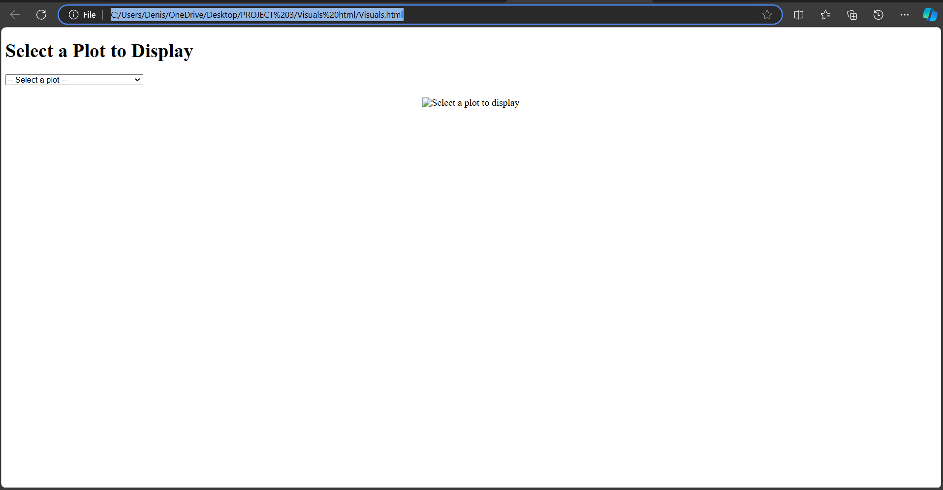
Where in the link are we?
HTML Visual

Slide 7
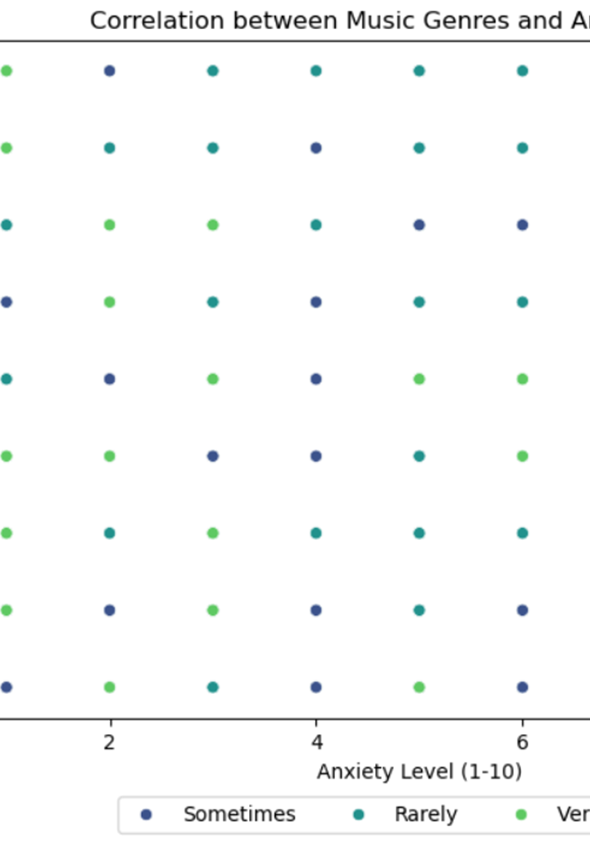
Anxiety level vs Genre
Top 3 Most listened to while:
Anxiety Level 7:
Pop
Rock
Classical
Anxiety Level 4:
Classical
Hip-Hop
Heavy Metal
Anxiety Level 0:
Hip-Hop
Folk
Metal

Slide 8
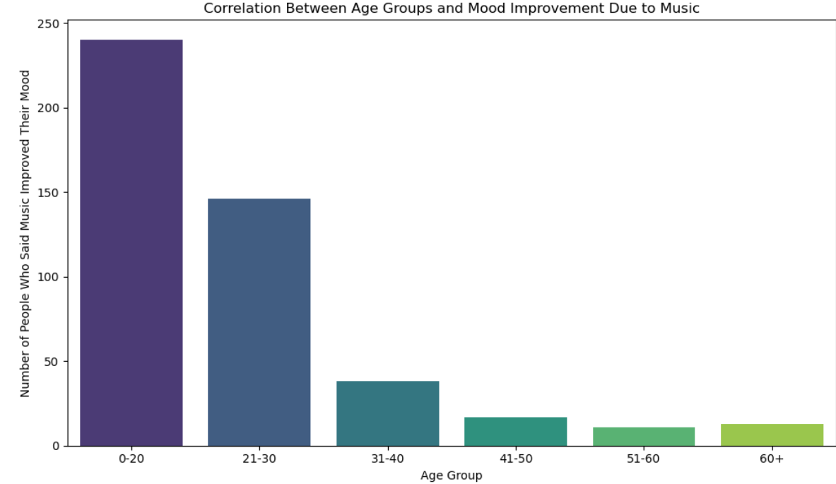
What say you?
Most improved based on age group:

Slide 9
Sum It Up
Music Therapy Success Factor:
Age
Music during daily activity
# Of Hours Played
Future Direction:
Correlate the Genre BPM, age, and mental illness
Are they musically inclined?
How often and how long is the person impacted by Mental Illness

Slide 10
Data Cleaning and Transformation
Denise Miller

Slide 11
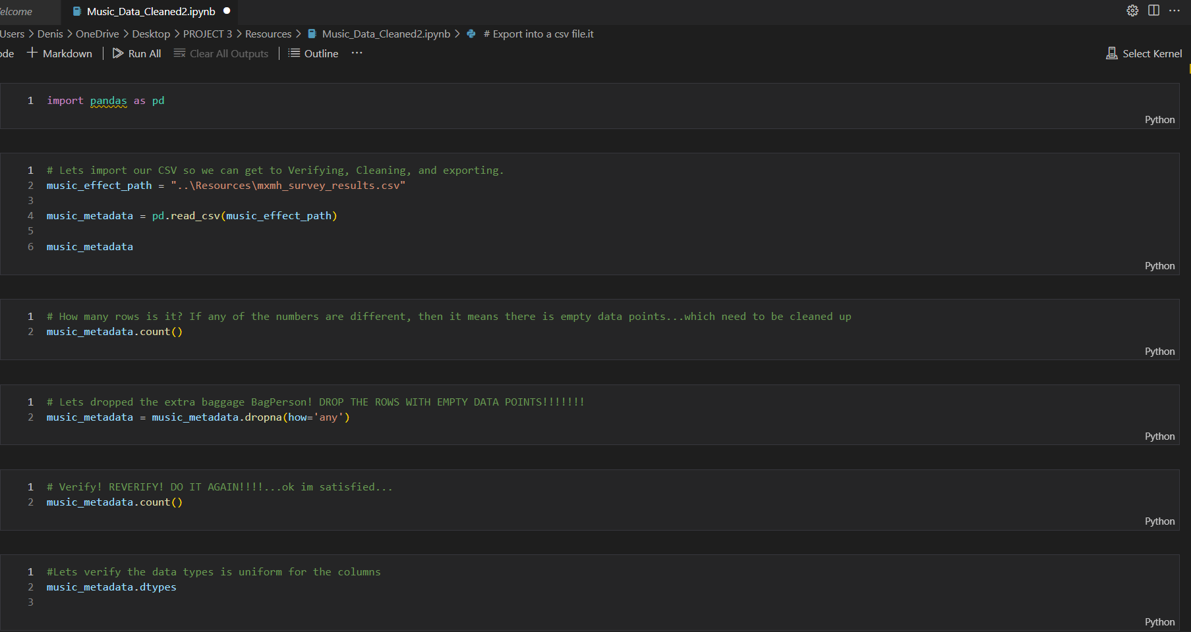
Step 1: Clean/Prepare
Import panda
Import Csv
Ensure no missing data: Row Count
Remove rows with missing data
Verify Data types
Export to a CSV file

Slide 12
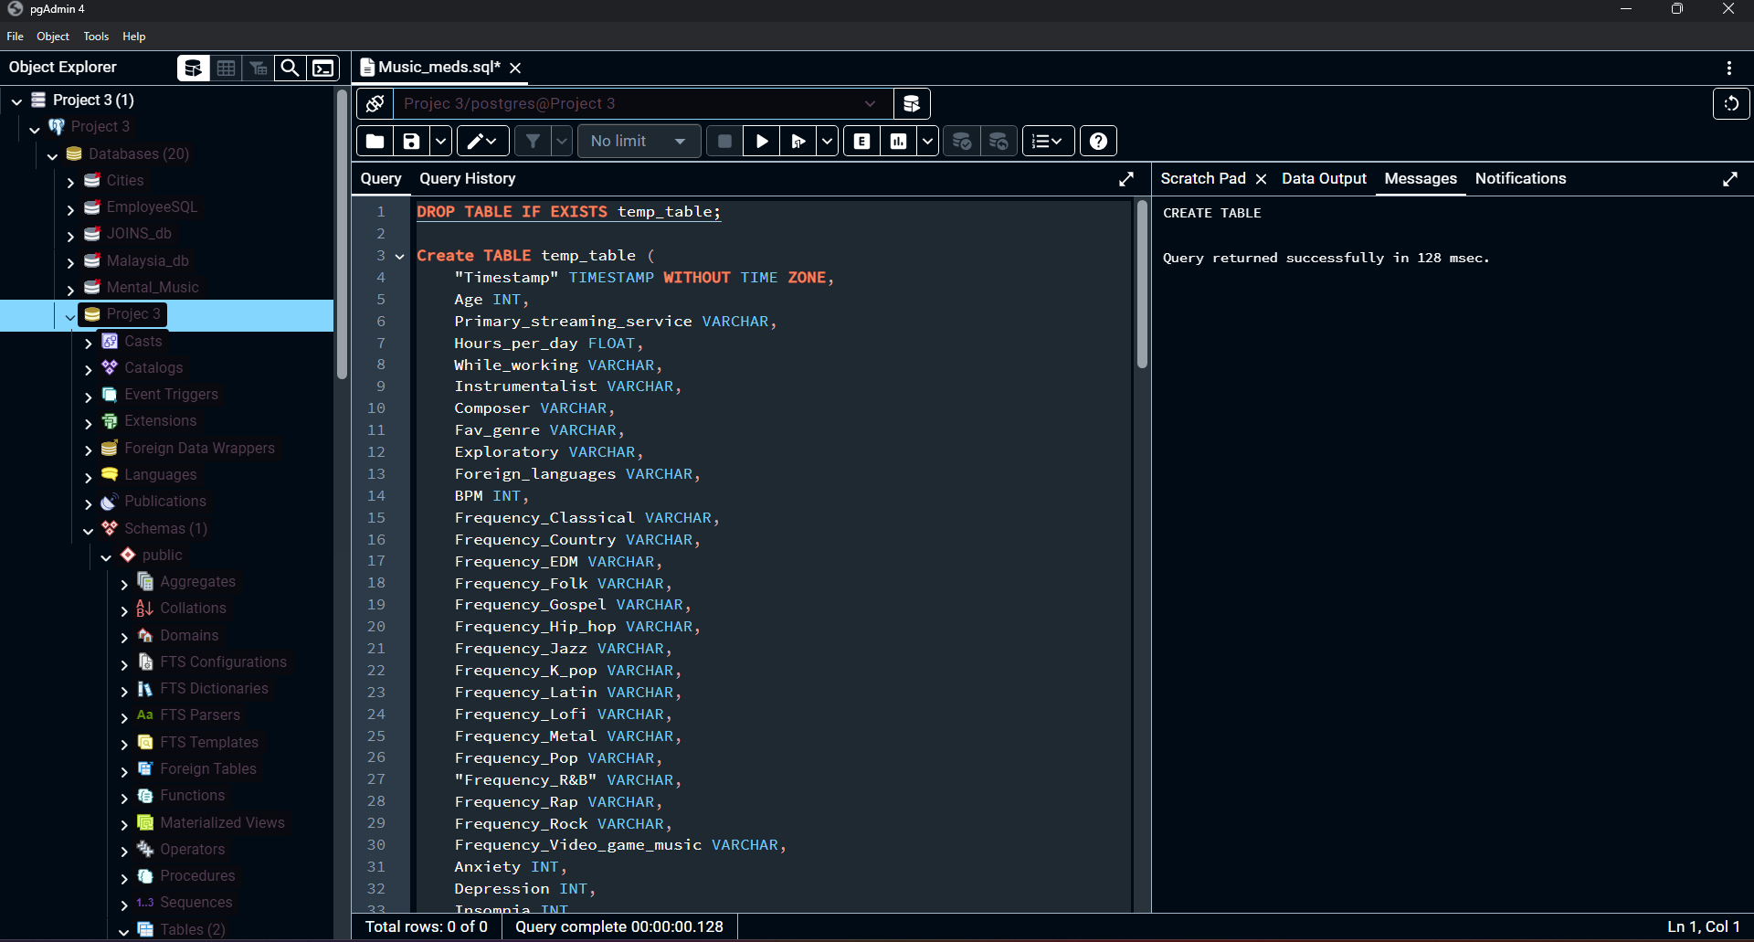
Step 2: Transform
Create Temp Table
Create new Table: less columns
Import cleaned data to new table
Export the table into a CSV file.

Slide 13
Visualization Path
Richard

Slide 14
Step 1:

Slide 15
Step 2:

Slide 16
Step 3:

Slide 17
Visualization Path
Titus Muchiri

Slide 18
Step 1:

Slide 19
Step 2:

Slide 20
Step 3:

Slide 21
End Credits/Resources
Kaggle
National Library of Medicine
National Heart, Lung, and Blood Institute
National Institute of Mental Health

